Slide 1
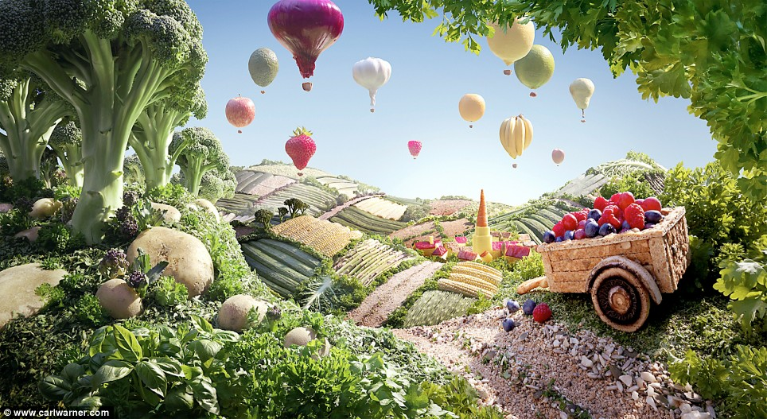
Photo by Carl Warner

Slide 2
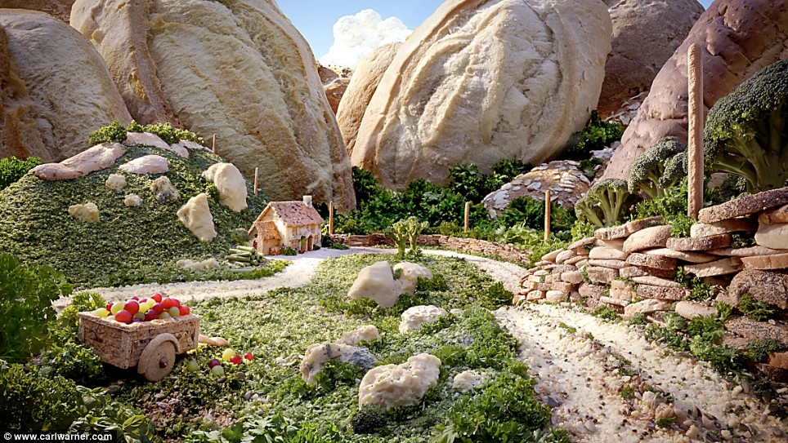
Photo by Carl Warner

Slide 3
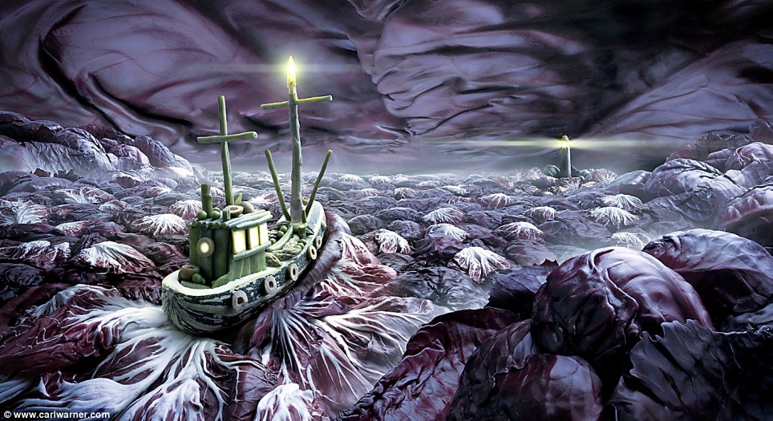
Photo by Carl Warner

Slide 4
Feature Matching and Robust Fitting
Read Szeliski 4.1
Computer Vision
James Hays
Acknowledgment: Many slides from Derek Hoiem and Grauman&Leibe 2008 AAAI Tutorial

Slide 5
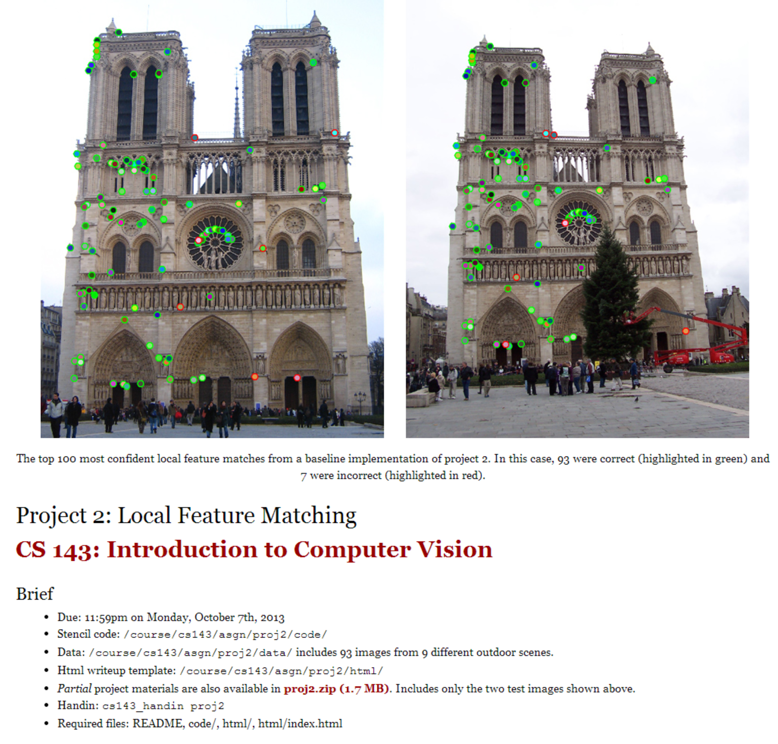
Project 2

Slide 6
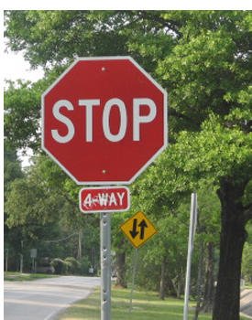
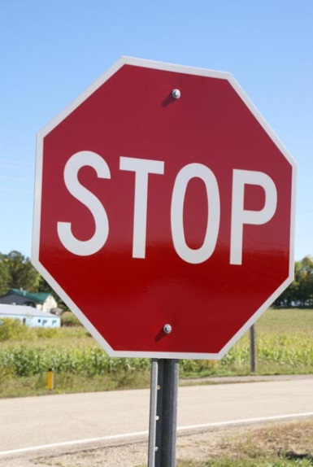
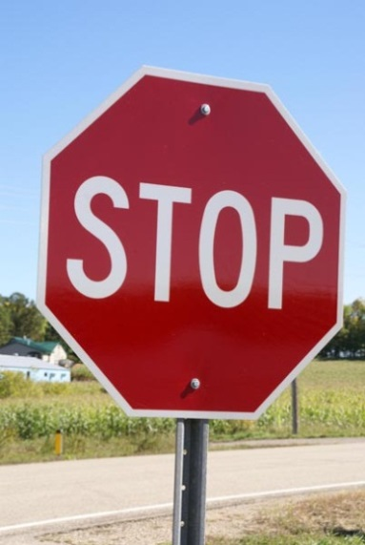
This section: correspondence and alignment
Correspondence: matching points, patches, edges, or regions across images
≈

Slide 7


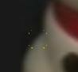
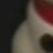
Overview of Keypoint Matching
1. Find a set of distinctive key- points
A₁
B₃
2. Define a region around each keypoint
A₂
A₃
B₁
B₂
3. Extract and normalize the region content
4. Compute a local descriptor from the normalized region
5. Match local descriptors

Slide 8
Harris Corners – Why so complicated?
Can’t we just check for regions with lots of gradients in the x and y directions?
No! A diagonal line would satisfy that criteria
Current Window

Slide 9
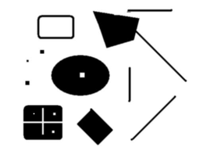
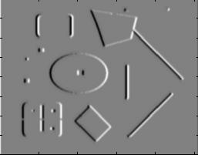
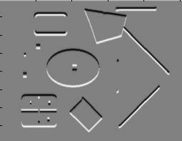
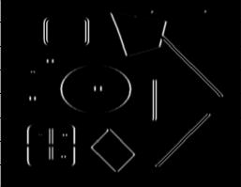
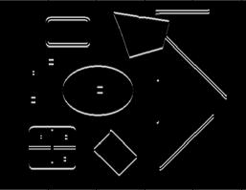
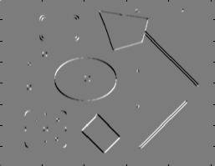
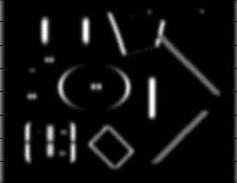
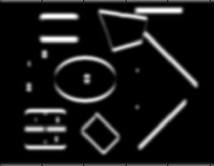
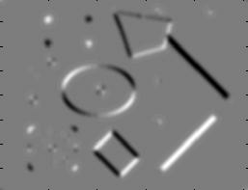
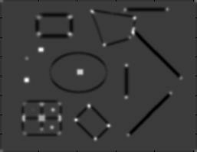
Harris Detector [Harris88]
Second moment matrix
1. Image derivatives
I_{x}
I_{y}
(optionally, blur first)
I_{x}²
I_{y}²
I_{x}I_{y}
2. Square of derivatives
3. Gaussian filter g(σ_{I})
g(I_{x}²)
g(I_{y}²)
g(I_{x}I_{y})
4. Cornerness function – both eigenvalues are strong
5. Non-maxima suppression
har

Slide 10
Harris Corners – Why so complicated?
Current Window
What does the structure matrix look here?

Slide 11
Harris Corners – Why so complicated?
Current Window
What does the structure matrix look here?

Slide 12
Harris Corners – Why so complicated?
Current Window
What does the structure matrix look here?

Slide 13
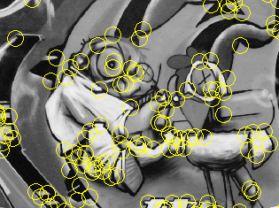
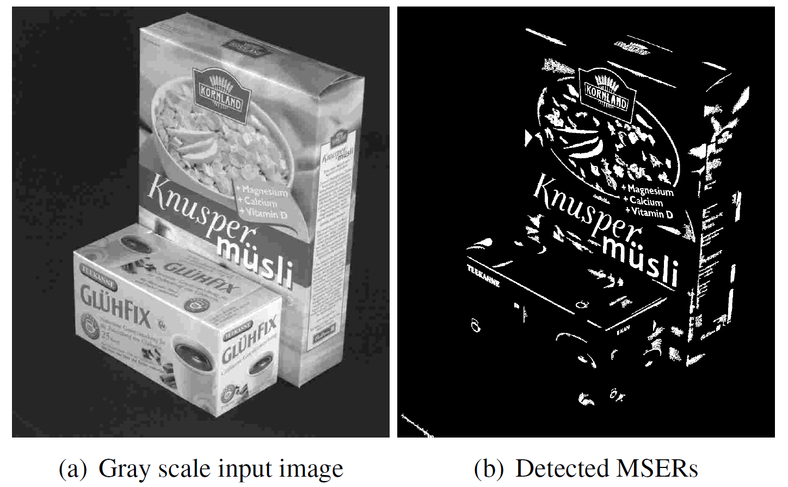
Review: Interest points
Keypoint detection: repeatable and distinctive
Corners, blobs, stable regions
Harris, DoG, MSER

Slide 14
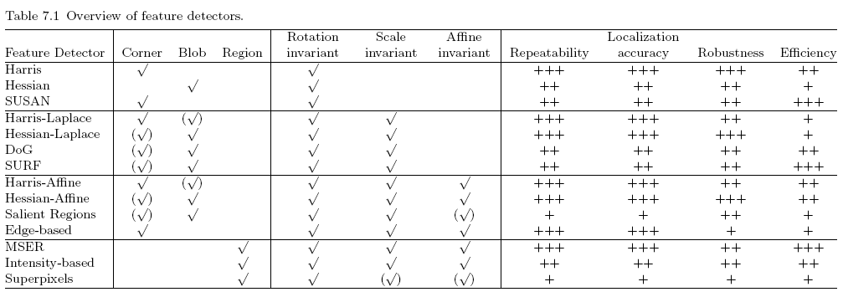
Comparison of Keypoint Detectors
Tuytelaars Mikolajczyk 2008

Slide 15
Review: Choosing an interest point detector
What do you want it for?
Precise localization in x-y: Harris
Good localization in scale: Difference of Gaussian
Flexible region shape: MSER
Best choice often application dependent
Harris-/Hessian-Laplace/DoG work well for many natural categories
MSER works well for buildings and printed things
Why choose?
Get more points with more detectors
There have been extensive evaluations/comparisons
[Mikolajczyk et al., IJCV’05, PAMI’05]
All detectors/descriptors shown here work well

Slide 16
Review: Local Descriptors
Most features can be thought of as templates, histograms (counts), or combinations
The ideal descriptor should be
Robust and Distinctive
Compact and Efficient
Most available descriptors focus on edge/gradient information
Capture texture information
Color rarely used

Slide 17
Feature Matching
Szeliski 4.1.3
Simple feature-space methods
Evaluation methods
Acceleration methods
Geometric verification (Chapter 6)

Slide 18
Feature Matching
Simple criteria: One feature matches to another if those features are nearest neighbors and their distance is below some threshold.
Problems:
Threshold is difficult to set
Non-distinctive features could have lots of close matches, only one of which is correct

Slide 19
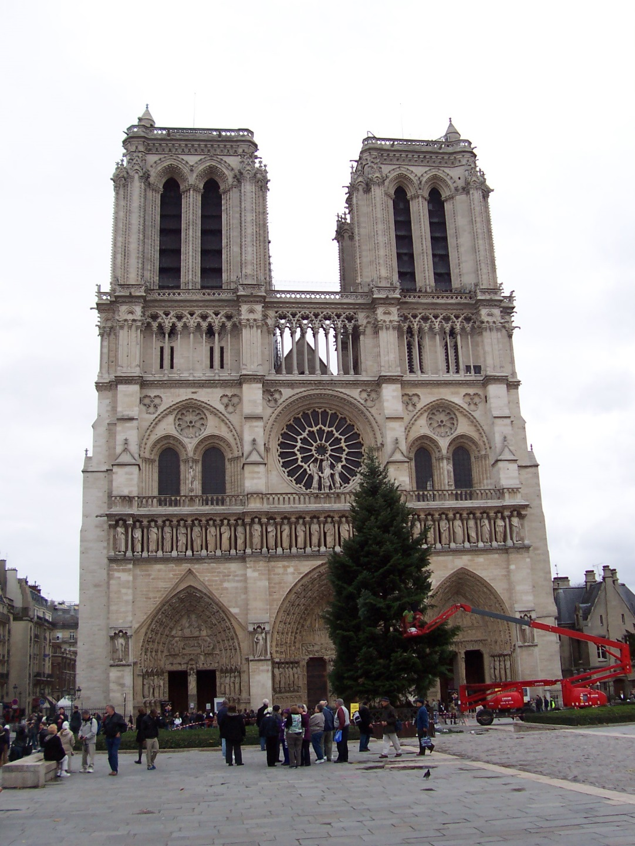
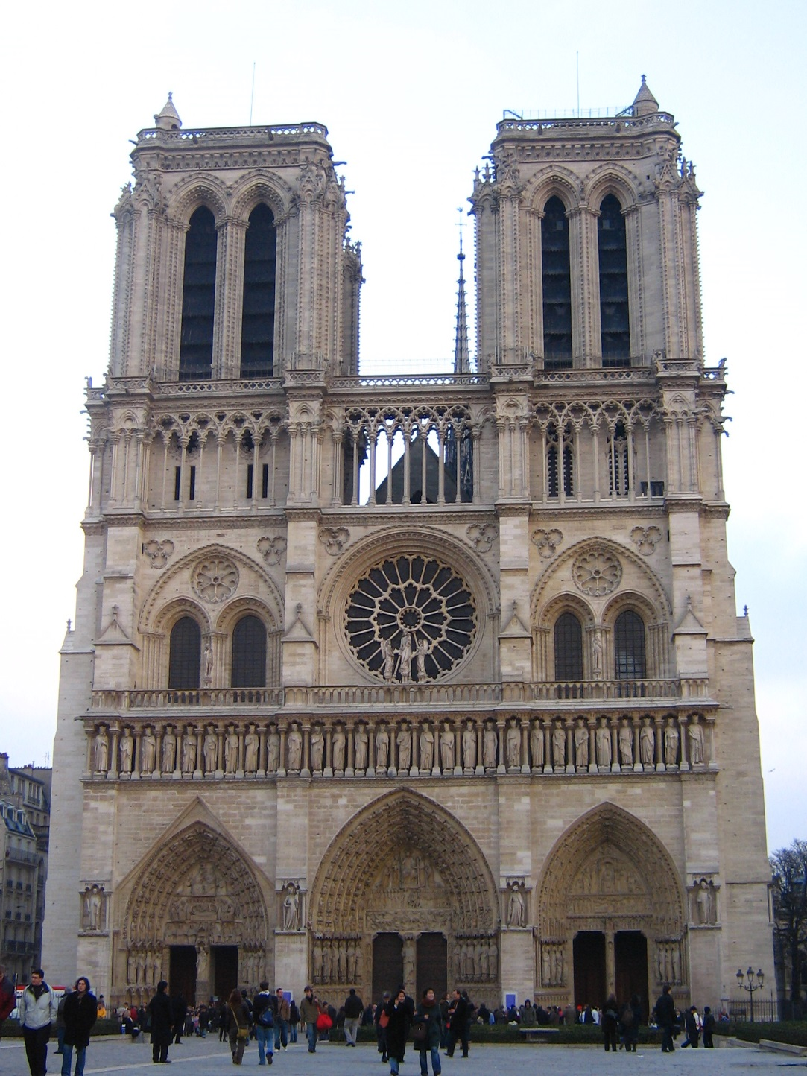
How do we decide which features match?
Distance: 0.34, 0.30, 0.40 Distance: 0.61, 1.22

Slide 20
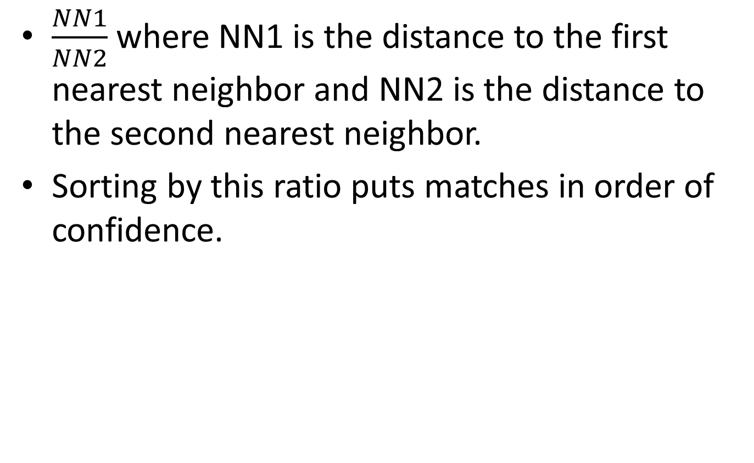
Nearest Neighbor Distance Ratio
$\frac{NN1}{NN2}$ where NN1 is the distance to the first nearest neighbor and NN2 is the distance to the second nearest neighbor.
Sorting by this ratio puts matches in order of confidence.

Slide 21
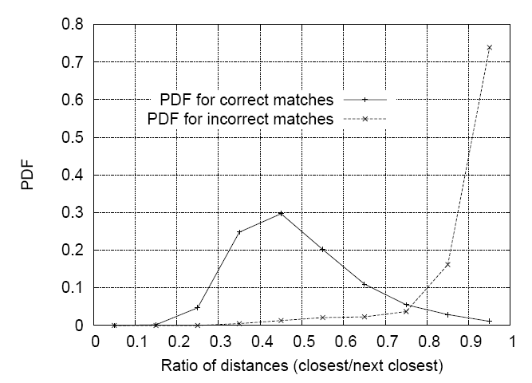
Matching Local Features
Threshold based on the ratio of 1st nearest neighbor to 2nd nearest neighbor distance.
Lowe IJCV 2004

Slide 22
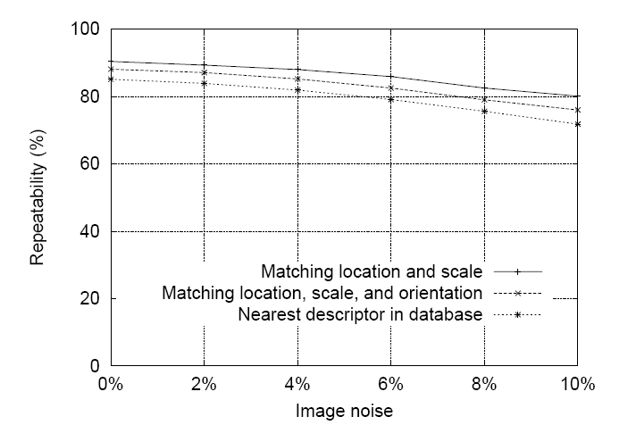
SIFT Repeatability
Lowe IJCV 2004

Slide 23
SIFT Repeatability

Slide 24
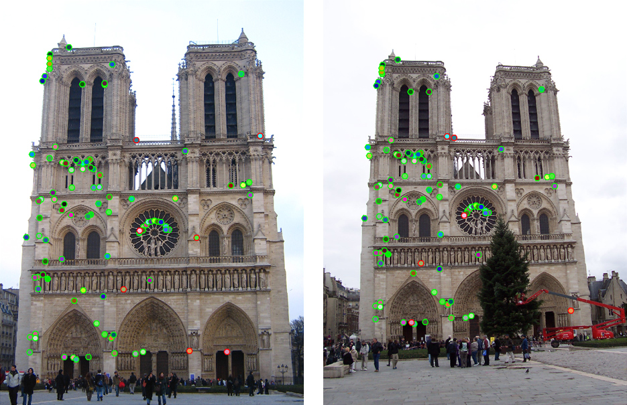
How do we decide which features match?

Slide 25
Fitting: find the parameters of a model that best fit the data
Alignment: find the parameters of the transformation that best align matched points

Slide 26
Fitting and Alignment
Design challenges
Design a suitable goodness of fit measure
Similarity should reflect application goals
Encode robustness to outliers and noise
Design an optimization method
Avoid local optima
Find best parameters quickly

Slide 27
Fitting and Alignment: Methods
Global optimization / Search for parameters
Least squares fit
Robust least squares
Iterative closest point (ICP)
Hypothesize and test
Generalized Hough transform
RANSAC

Slide 28
Simple example: Fitting a line

Slide 29
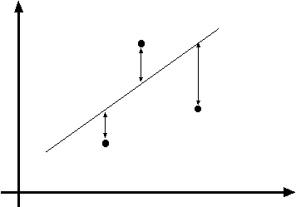
Least squares line fitting
Data: (x₁, y₁), …, (x_{n}, y_{n})
Line equation: y_{i} = m x_{i} + b
Find (m, b) to minimize
y=mx+b
(x_{i}, y_{i})
Matlab: p = A \ y;
Modified from S. Lazebnik

Slide 30
Problem with “vertical” least squares
Not rotation-invariant
Fails completely for vertical lines
Slide from S. Lazebnik

Slide 31
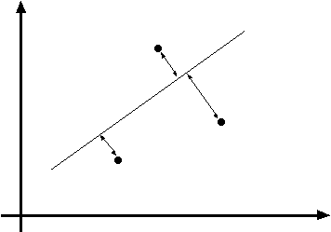
Total least squares
Slide modified from S. Lazebnik
If (a²+b²=1) then
Distance between point (x_{i}, y_{i}) is
|ax_{i} + by_{i} + c|
ax+by+c=0
Unit normal: N=(a, b)
(x_{i}, y_{i})
proof: http://mathworld.wolfram.com/Point-LineDistance2-Dimensional.html

Slide 32
Total least squares
Slide modified from S. Lazebnik
If (a²+b²=1) then
Distance between point (x_{i}, y_{i}) is
|ax_{i} + by_{i} + c|
Find (a, b, c) to minimize the sum of squared perpendicular distances
ax+by+c=0
Unit normal: N=(a, b)
(x_{i}, y_{i})

Slide 33
Total least squares
Slide modified from S. Lazebnik
Find (a, b, c) to minimize the sum of squared perpendicular distances
ax+by+c=0
Unit normal: N=(a, b)
(x_{i}, y_{i})
Solution is eigenvector corresponding to smallest eigenvalue of A^{T}A
See details on Raleigh Quotient: http://en.wikipedia.org/wiki/Rayleigh_quotient

Slide 34
Recap: Two Common Optimization Problems
Problem statement
Solution
(matlab)
Problem statement
Solution

Slide 35
Least squares (global) optimization
Good
Clearly specified objective
Optimization is easy
Bad
May not be what you want to optimize
Sensitive to outliers
Bad matches, extra points
Doesn’t allow you to get multiple good fits
Detecting multiple objects, lines, etc.

Slide 36
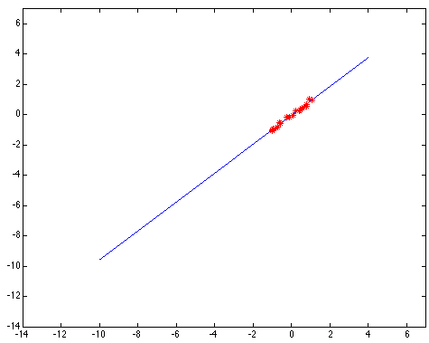
Least squares: Robustness to noise
Least squares fit to the red points:

Slide 37
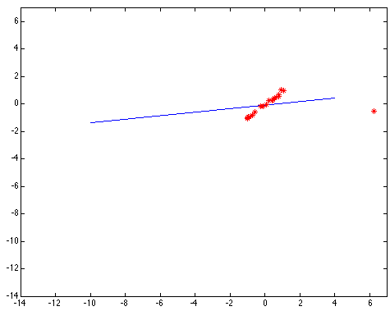
Least squares: Robustness to noise
Least squares fit with an outlier:
Problem: squared error heavily penalizes outliers

Slide 38
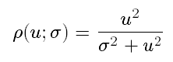
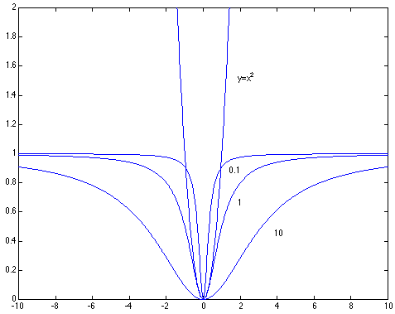
Robust least squares (to deal with outliers)
General approach:
minimize
u_{i} (x_{i}, θ) – residual of i^{th} point w.r.t. model parameters θ ρ – robust function with scale parameter σ
The robust function ρ
Favors a configuration
with small residuals
Constant penalty for large residuals
Slide from S. Savarese

Slide 39

Choosing the scale: Just right
The effect of the outlier is minimized
Notes:
Fit to earlier data with an appropriate choice of s

Slide 40
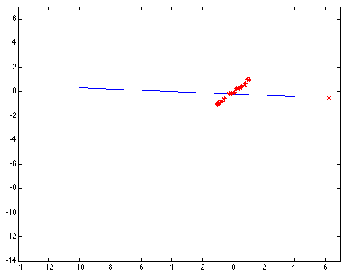
Choosing the scale: Too small
The error value is almost the same for every point and the fit is very poor

Slide 41

Choosing the scale: Too large
Behaves much the same as least squares

Slide 42
Robust estimation: Details
Robust fitting is a nonlinear optimization problem that must be solved iteratively
Least squares solution can be used for initialization
Scale of robust function should be chosen adaptively based on median residual

Slide 43
Other ways to search for parameters (for when no closed form solution exists)
Line search
For each parameter, step through values and choose value that gives best fit
Repeat (1) until no parameter changes
Grid search
Propose several sets of parameters, evenly sampled in the joint set
Choose best (or top few) and sample joint parameters around the current best; repeat
Gradient descent
Provide initial position (e.g., random)
Locally search for better parameters by following gradient

Slide 44
Hypothesize and test
Propose parameters
Try all possible
Each point votes for all consistent parameters
Repeatedly sample enough points to solve for parameters
Score the given parameters
Number of consistent points, possibly weighted by distance
Choose from among the set of parameters
Global or local maximum of scores
Possibly refine parameters using inliers

Slide 45
Hough Transform: Outline
Create a grid of parameter values
Each point votes for a set of parameters, incrementing those values in grid
Find maximum or local maxima in grid

Slide 46
Hough transform
P.V.C. Hough, Machine Analysis of Bubble Chamber Pictures, Proc. Int. Conf. High Energy Accelerators and Instrumentation, 1959
Given a set of points, find the curve or line that explains the data points best
y
m
x
b
Hough space
y = m x + b
Slide from S. Savarese
Notes:
􀁑 Basic ideas
• A line is represented as . Every line in the image corresponds
to a point in the parameter space
• Every point in the image domain corresponds to a line in the parameter
space (why ? Fix (x,y), (m,n) can change on the line . In other
words, for all the lines passing through (x,y) in the image space, their
parameters form a line in the parameter space)
• Points along a line in the space correspond to lines passing through the
same point in the parameter space (why ?)

Slide 47
Hough transform
y
m
x
b
y
m
3
5
3
3
2
2
3
7
11
10
4
3
2
3
1
4
5
2
2
1
0
1
3
3
x
b
Slide from S. Savarese
Notes:
􀁑 Basic ideas
• A line is represented as . Every line in the image corresponds
to a point in the parameter space
• Every point in the image domain corresponds to a line in the parameter
space (why ? Fix (x,y), (m,n) can change on the line . In other
words, for all the lines passing through (x,y) in the image space, their
parameters form a line in the parameter space)
• Points along a line in the space correspond to lines passing through the
same point in the parameter space (why ?)

Slide 48
Hough transform
P.V.C. Hough, Machine Analysis of Bubble Chamber Pictures, Proc. Int. Conf. High Energy Accelerators and Instrumentation, 1959
Issue : parameter space [m,b] is unbounded…
Use a polar representation for the parameter space
y
x
Hough space
Slide from S. Savarese
Notes:
􀁑 Basic ideas
• A line is represented as . Every line in the image corresponds
to a point in the parameter space
• Every point in the image domain corresponds to a line in the parameter
space (why ? Fix (x,y), (m,n) can change on the line . In other
words, for all the lines passing through (x,y) in the image space, their
parameters form a line in the parameter space)
• Points along a line in the space correspond to lines passing through the
same point in the parameter space (why ?)

Slide 49
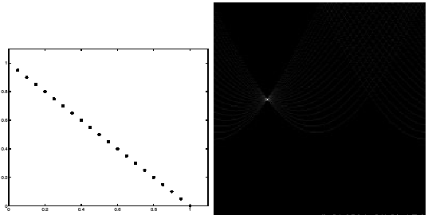
Hough transform - experiments
features
votes
Slide from S. Savarese
Notes:
Figure 15.1, top half. Note that most points in the vote array are very dark, because they
get only one vote.

Slide 50
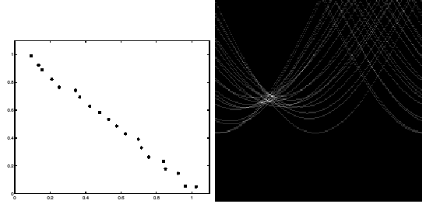
Hough transform - experiments
Noisy data
features
votes
Need to adjust grid size or smooth
Slide from S. Savarese
Notes:
This is 15.1 lower half

Slide 51
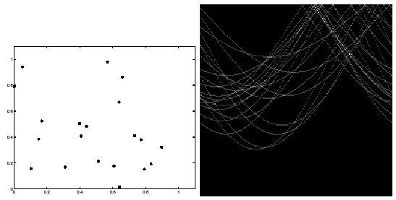
Hough transform - experiments
features
votes
Issue: spurious peaks due to uniform noise
Slide from S. Savarese
Notes:
15.2; main point is that lots of noise can lead to large peaks in the array

Slide 52
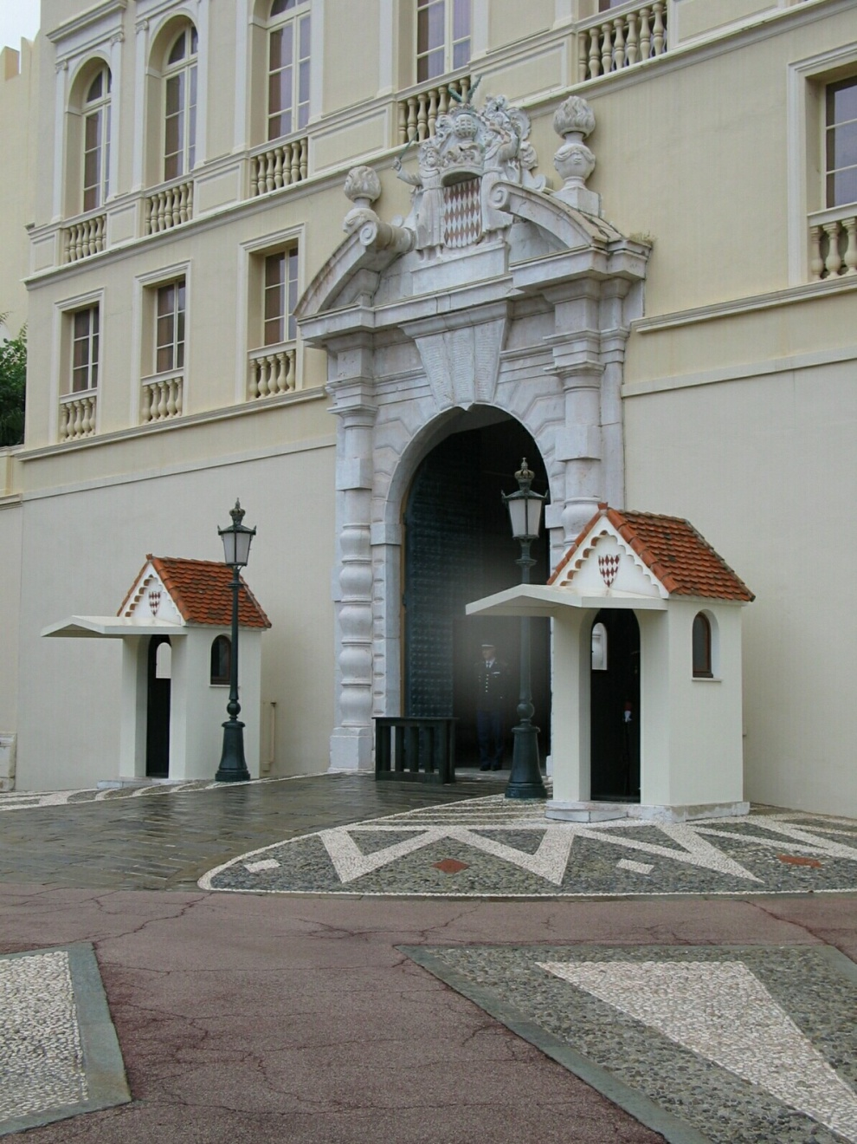
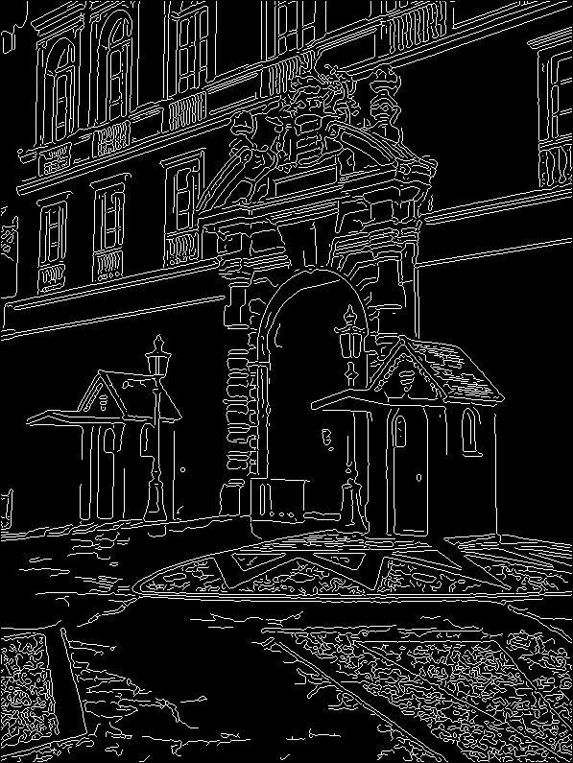
1. Image → Canny

Slide 53
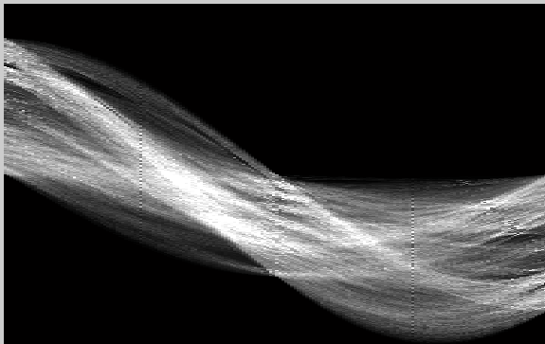
2. Canny → Hough votes

Slide 54
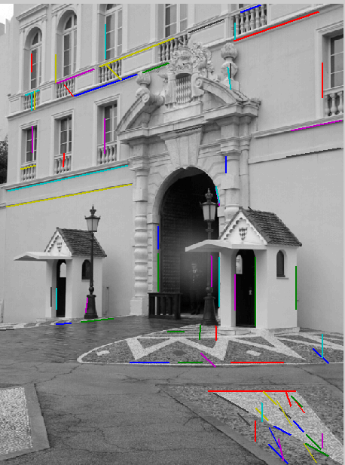
3. Hough votes → Edges
Find peaks and post-process

Slide 55
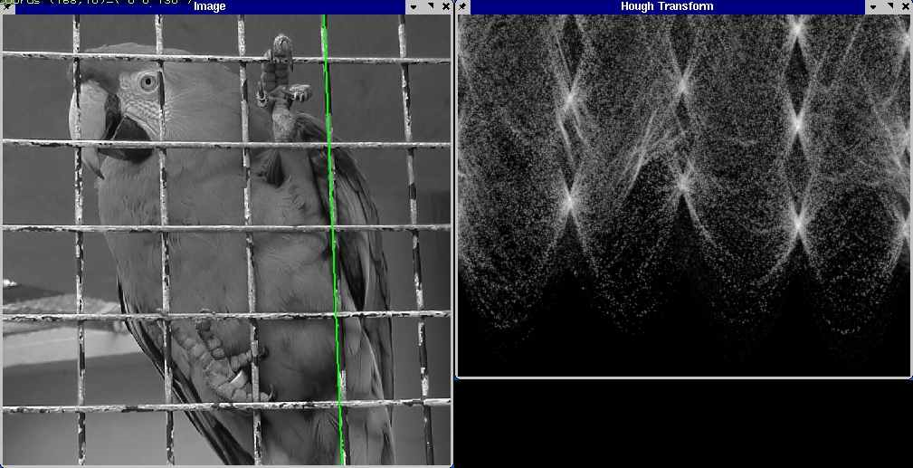
Hough transform example
http://ostatic.com/files/images/ss_hough.jpg

Slide 56


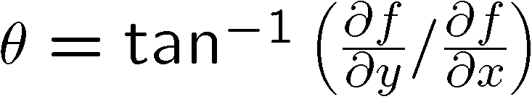
Incorporating image gradients
Recall: when we detect an edge point, we also know its gradient direction
But this means that the line is uniquely determined!
Modified Hough transform:
For each edge point (x,y) θ = gradient orientation at (x,y) ρ = x cos θ + y sin θ H(θ, ρ) = H(θ, ρ) + 1 end

Slide 57
Finding lines using Hough transform
Using m,b parameterization
Using r, theta parameterization
Using oriented gradients
Practical considerations
Bin size
Smoothing
Finding multiple lines
Finding line segments

Slide 58
Hough Transform
How would we find circles?
Of fixed radius
Of unknown radius
Of unknown radius but with known edge orientation

Slide 59
Next lecture
RANSAC
Connecting model fitting with feature matching

